Slide 1
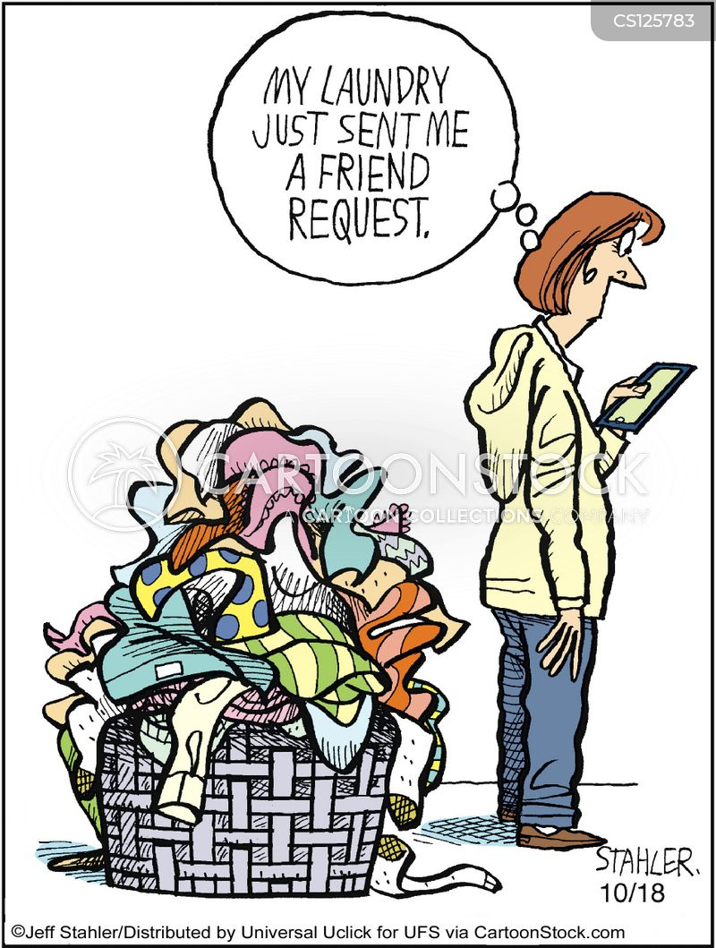
I-Washer Dryer
Nepal Himal Center
”Quality is never an accident.It is an intention of skill execution and intelligent direction.

Slide 2
Menu
TEDIOUS WASHING
REASONABLE DRYER AND WASHER SET
WHY CHOOSE US
OUR SOLUTION
OUR TARGET CUSTOMERS
CONCLUSION

Slide 3

TODAY’S TEDIOUS WASHING
HOURS IN LAUNDRY
LAUNDRY IN DORMS
63% STUDENTS HAVE PROBLEM
Hesen, Li, and Luo Ying. “Laundry Model, and Tried to Change and Solve the Status Quo and Problems of Laundry during The.” n. pag. Web.

Slide 4
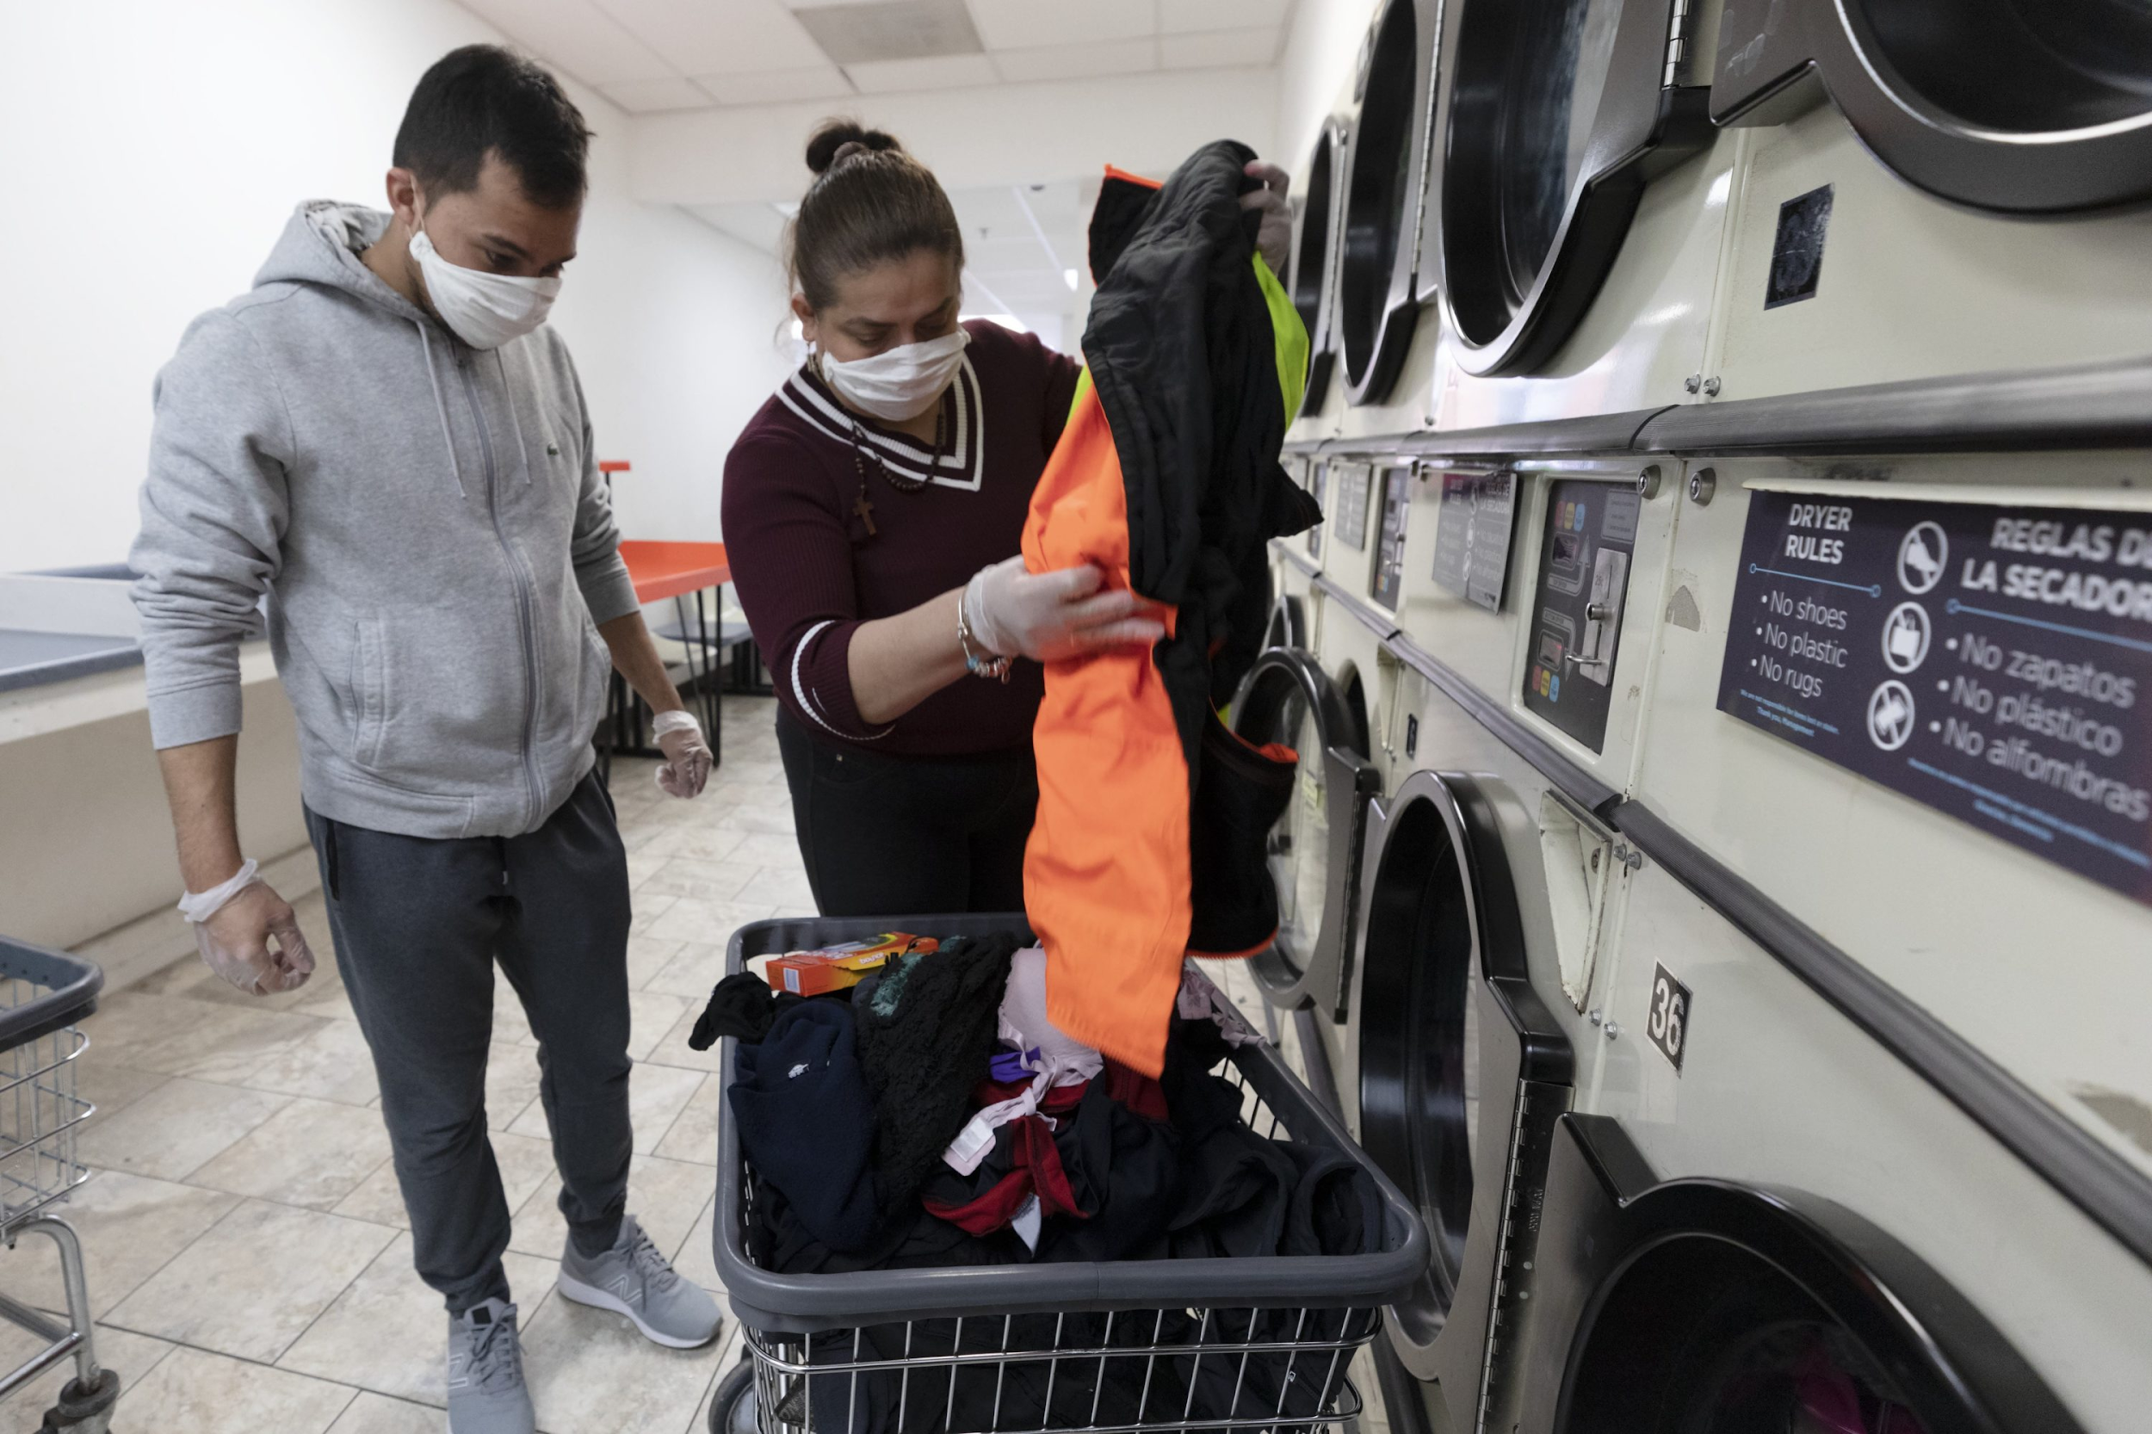
WHY “NHEC”
BUDGET-FRIENDLY($500 VS $2000)
RELIABLE(UV RAYS )
CONVENIENT(IOT VS CHAIN)

Slide 5
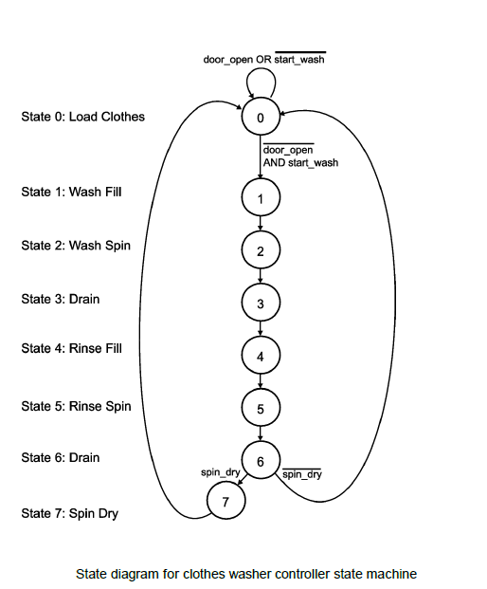
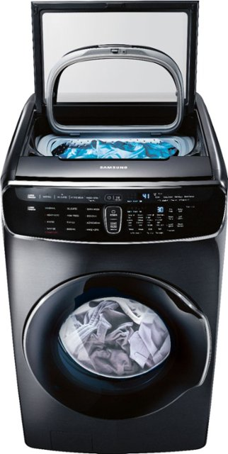
DRYER AND WASHER SET
TIME CONVENIENT
HASSLE FREE
CHEAPER

Slide 6
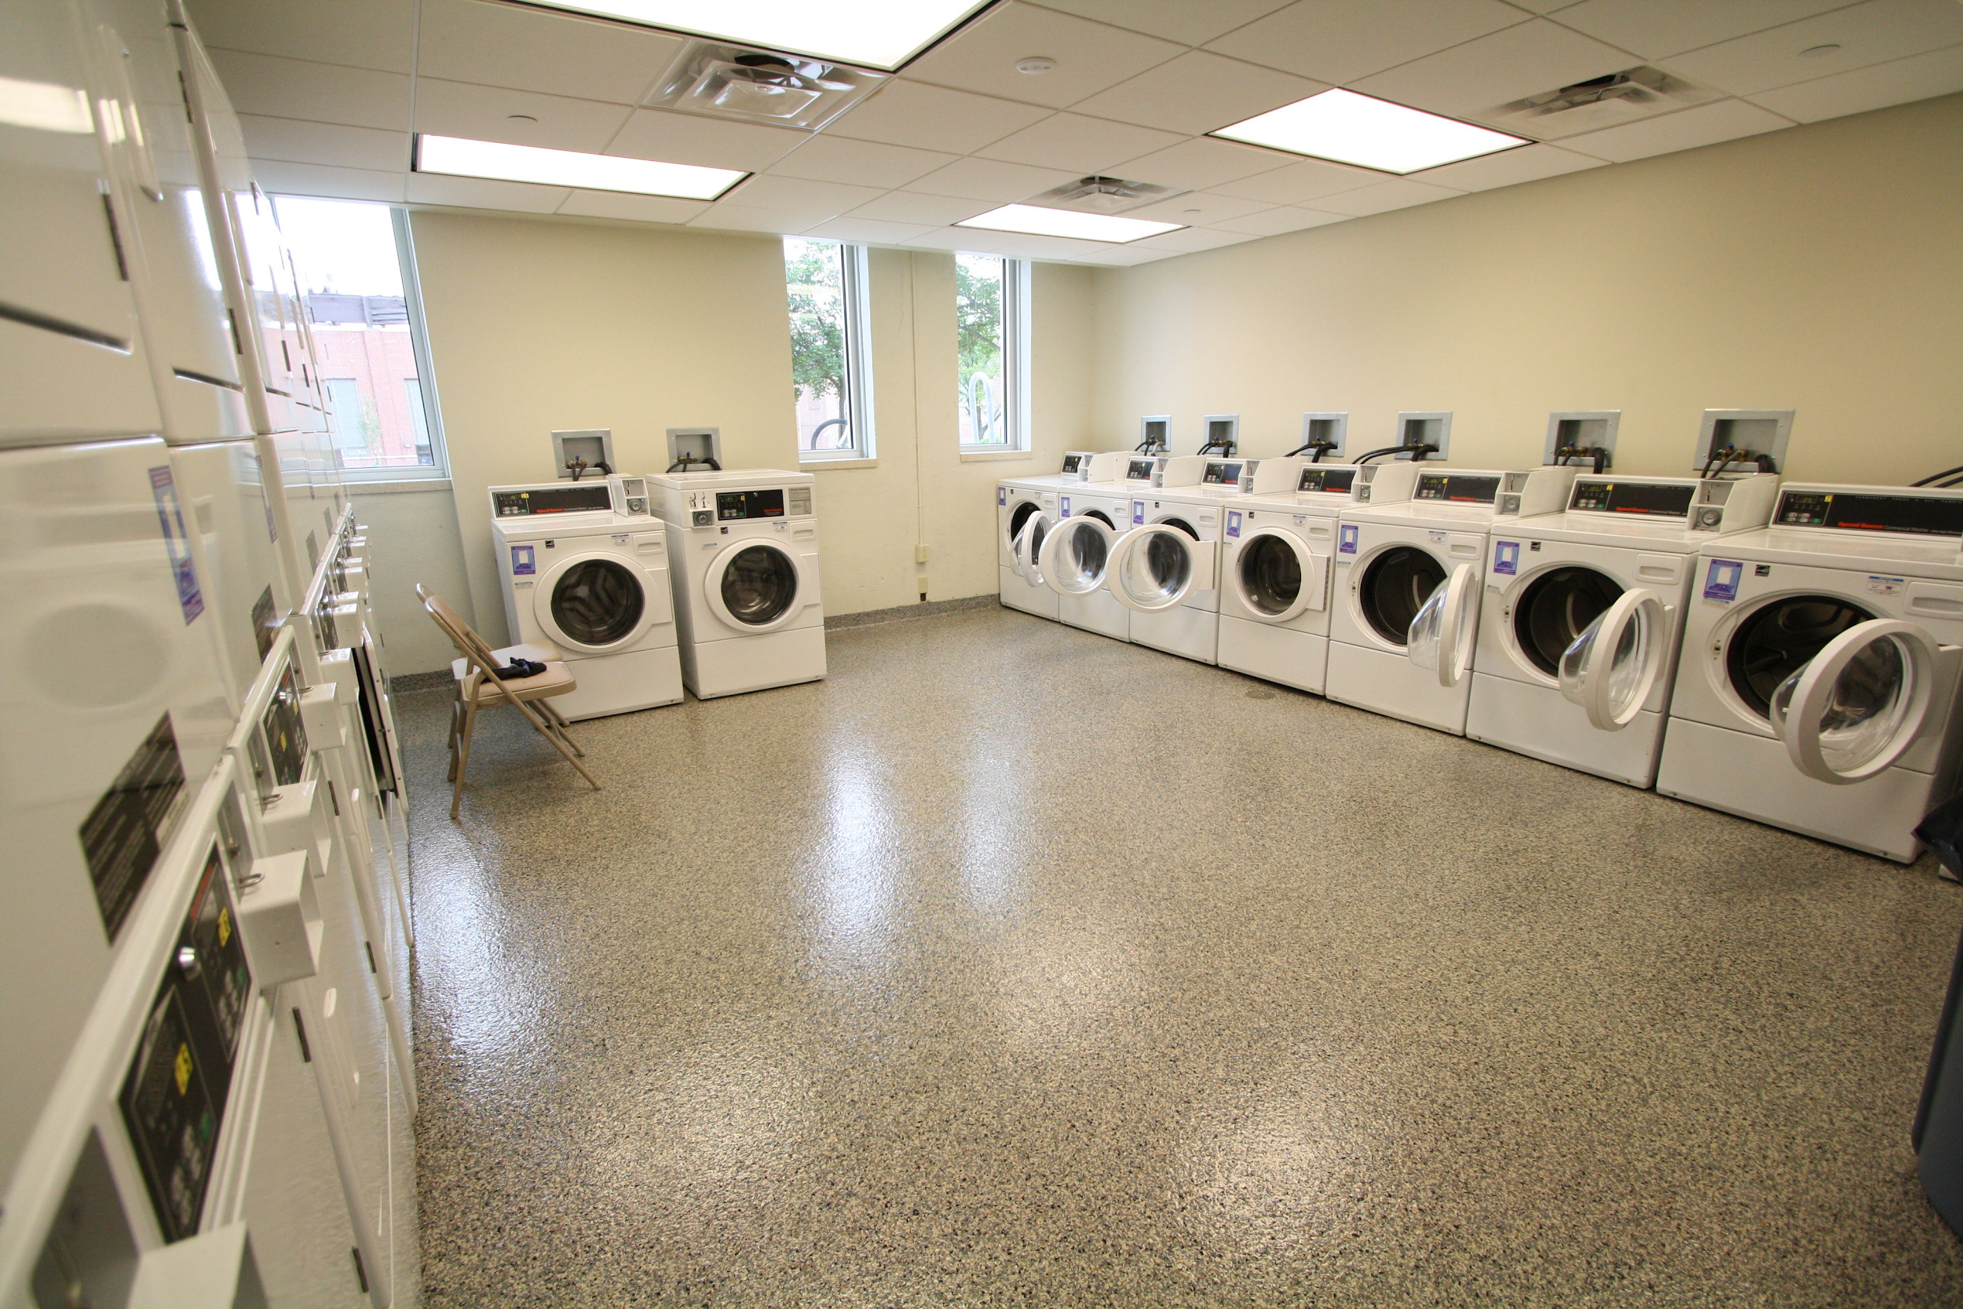
OUR TARGET CUSTOMERS
COLLEGE STUDENT
APARTMENT
ANYONE IN LIMITED BUDGET

Slide 7

Thank you!
Do you have any questions?
nhec@mos.com.np
+977-9851027014
www.nhec..com

